Slide 1
[Lab 0] How To Report A Measurement
Any reported measurement must include:
A Best Estimate
An Uncertainty
Units
If any of these are missing, the measurement is meaningless! Additionally we require that:
The decimal precision of the Best Estimate and Uncertainty should match
You should not have more than 2 significant figures in your uncertainty
Since extra decimal places would imply more knowledge than is consistent with the uncertainty.
An example of a measurement following these guidelines would be a height measurement like this:
1.72+/-.01 meters

Slide 2
[Lab 0] Systematic Uncertainty
There are two kinds of measuring devices we will encounter in lab this semester, analog and digital.
The uncertainty in an analog device is generally given by ½ the increment of the markings. For example if a meterstick includes marking to the centimeter, the uncertainty is ½ cm. Of course it could be more or less than this depending on how you use the device.
The uncertainty in a digital device is generally larger, since we cannot see any indication of the next digit at all. For example, if a digital stopwatch reports to the millisecond, the uncertainty is 1 ms. Of course it could be more or less than this depending on how you use the device.
It’s important to remember that measuring devices have uncertainty due to imperfections. We will always assume it is smaller than the reported precision and so this is covered by the above.

Slide 3
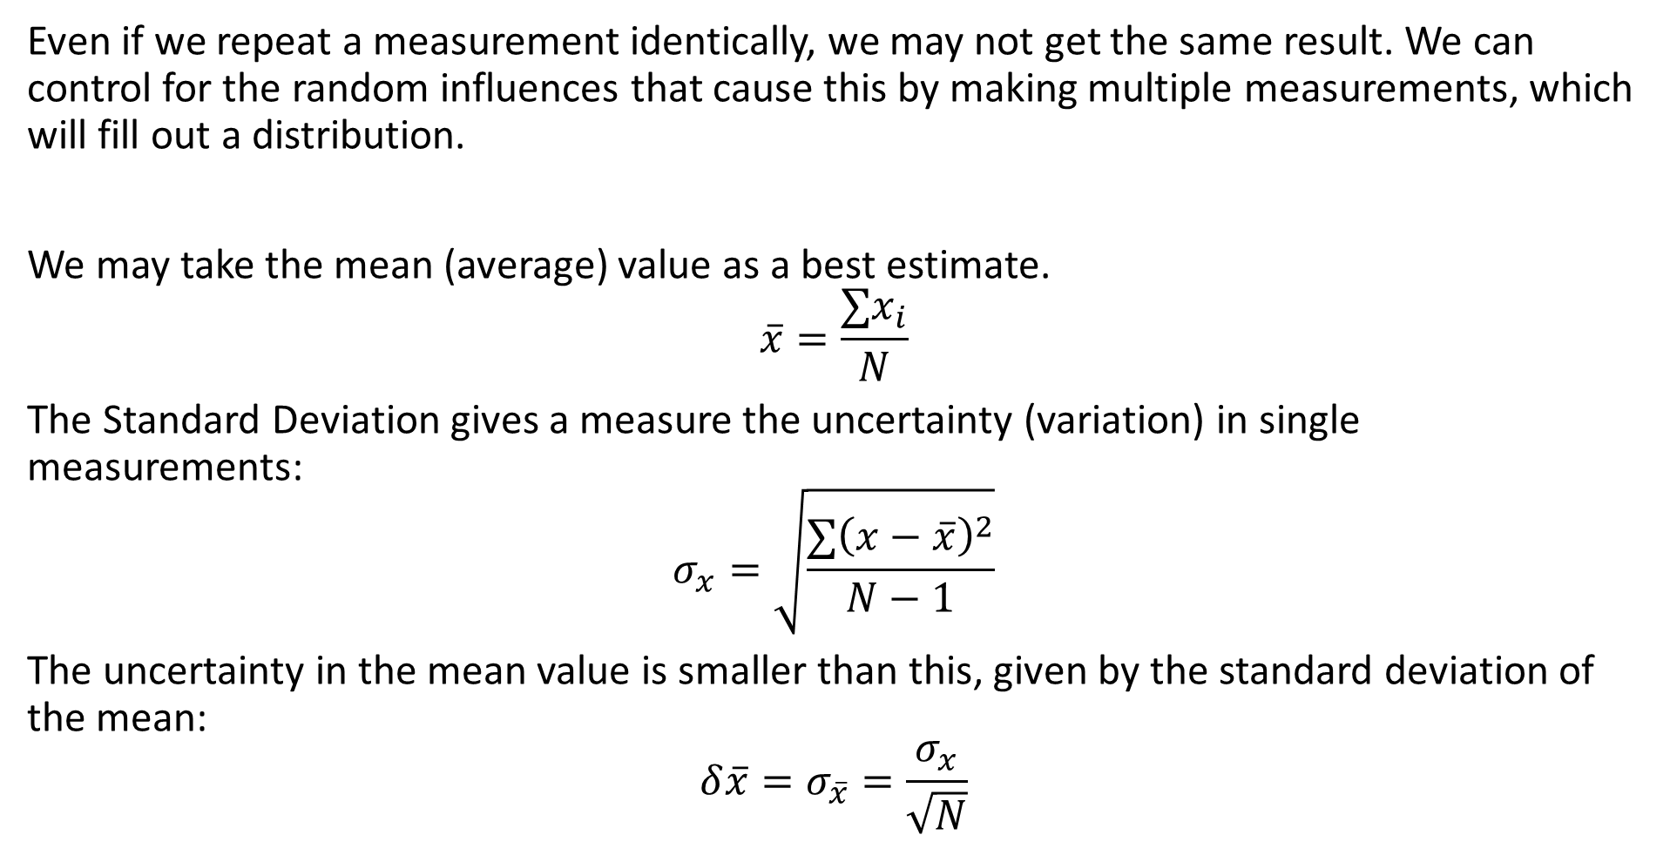
[Lab 0] Random Uncertainty
Even if we repeat a measurement identically, we may not get the same result. We can control for the random influences that cause this by making multiple measurements, which will fill out a distribution.
We may take the mean (average) value as a best estimate.
$$\overline{x}=\frac{∑x_{i}}{N}$$
The Standard Deviation gives a measure the uncertainty (variation) in single measurements:
$$σ_{x}=\sqrt{\frac{∑{\left(x−\overline{x}\right)}^{2}}{N−1}}$$
The uncertainty in the mean value is smaller than this, given by the standard deviation of the mean:
$$δ\overline{x}=σ_{\overline{x}}=\frac{σ_{x}}{\sqrt{N}}$$

Slide 4
[Lab 0] Combining Uncertainties
If we have multiple sources of uncertainty (for example both systematic and random uncertainty) then us the larger of the two.

